Slide 1
OIL PRICE PREDICTION
Mentored By :-
Aishwarya Mate
Group Members. :-
1.Sonal Madan Bagde
2.Chaitali Dattatray Mandge
3.Samiksha Sukhdeo Suryawansh
4.Rushikesh Subhash Patil
5.Chaitanya Ramdas Narhe
6.Aniket Baburao Dhotre

Slide 2
INTRODUCTION
Oil prices continue to be a major concern for various industries, governments, and the global economy.
The drastic fluctuations in oil prices have a significant impact on the world market, national currencies, and daily life.
Time series forecasting aims to predict future values based on historical trends.
This presentation focuses on the use of time series forecasting techniques to predict oil prices.
We will explore various forecasting methods and tools that can be used to analyze historical data, and make predictions for future trends in oil prices.

Slide 3
PROBLEM STATEMENT
Oil prices are difficult to forecast due to externalities, but our aim is to build the model which can help us to understand the pattern and make smart decision for customers and businesses.

Slide 4
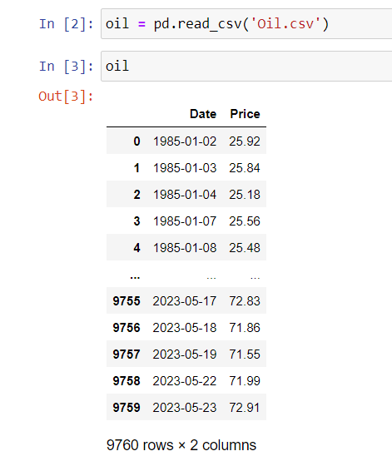
DATASET
We extract the data from investing.com website.
Our data consists of 9760 rows and 2 columns.

Slide 5
PROJECT FLOW
Data Collection
EDA
and preprocessing
Feature Extraction
Building Prediction Models
Train,Test,
Validate
the Model
Evaluation of Model
Model Deployment

Slide 6

EDA
(Exploratory Data Analysis)

Slide 7
DATA PROCESSING
The data consists of 9760 rows and 2 columns.
We observe that Date column have 'object' datatype. So we convert object datatype to datetime.
After the above processing, we checked for the null values and no null values were present in the dataset.
Also, the dataset does not contain any duplicate values.

Slide 8
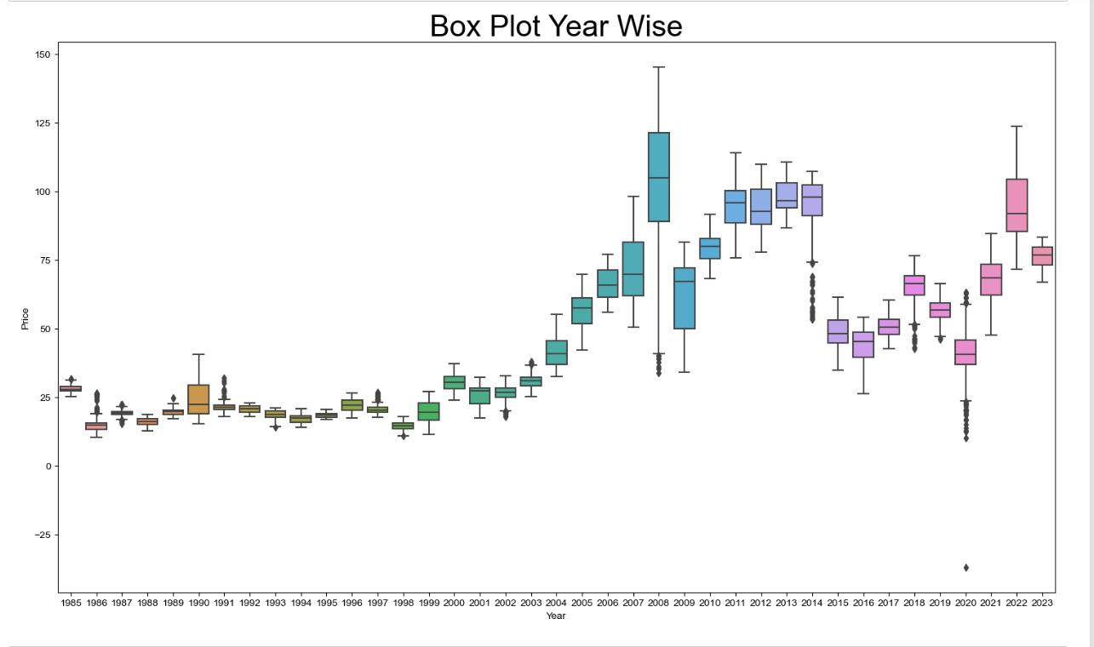
OUTLIER DETECTION
From the box plot, it is observed that the year wise outliers present in our dataset

Slide 9
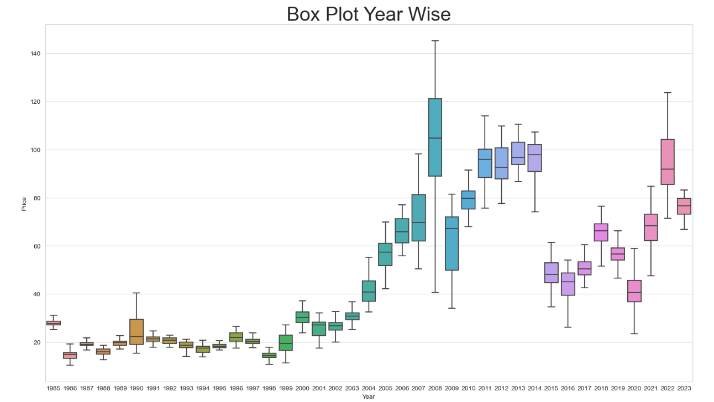
OUTLIER REPLACE
So we can see that outliers replace with capping method.

Slide 10
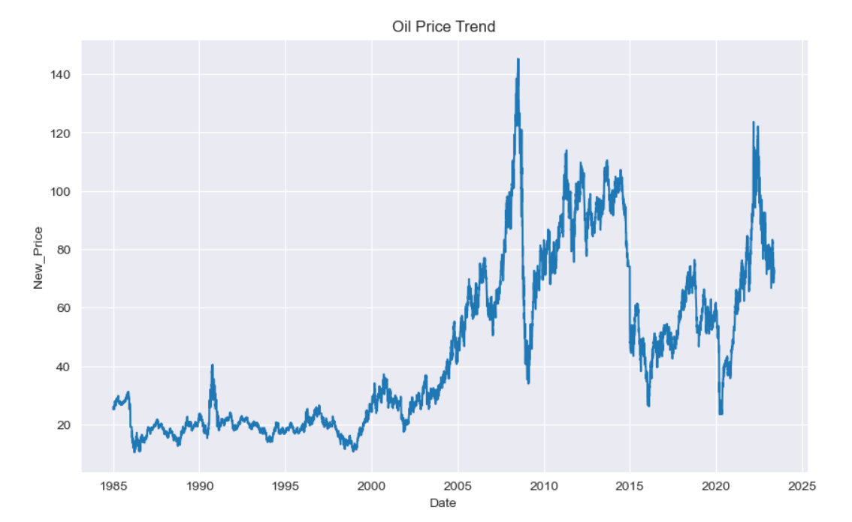
DATA VISUALISATION

Slide 11
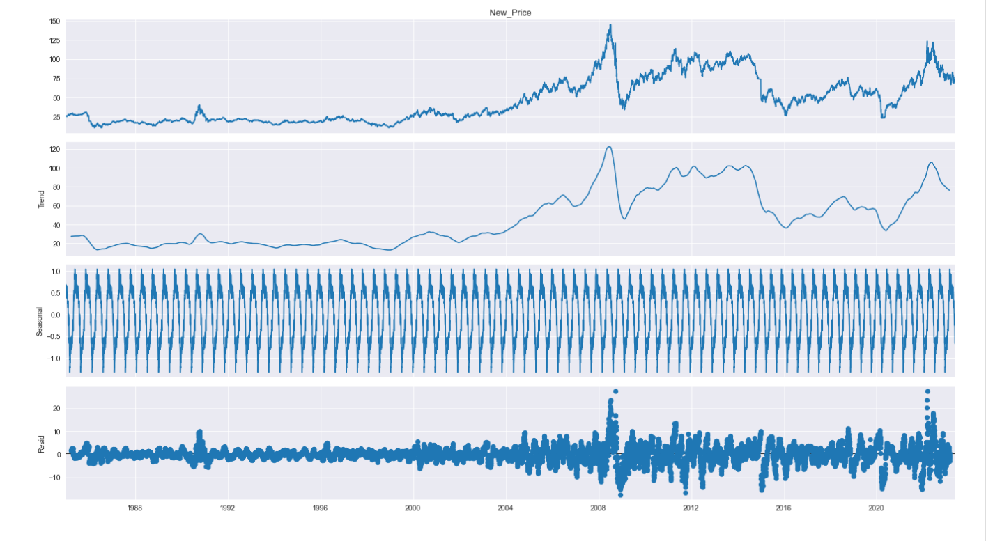
TIME SERIES DECOMPOSITION

Slide 12

Feature Engineering

Slide 13
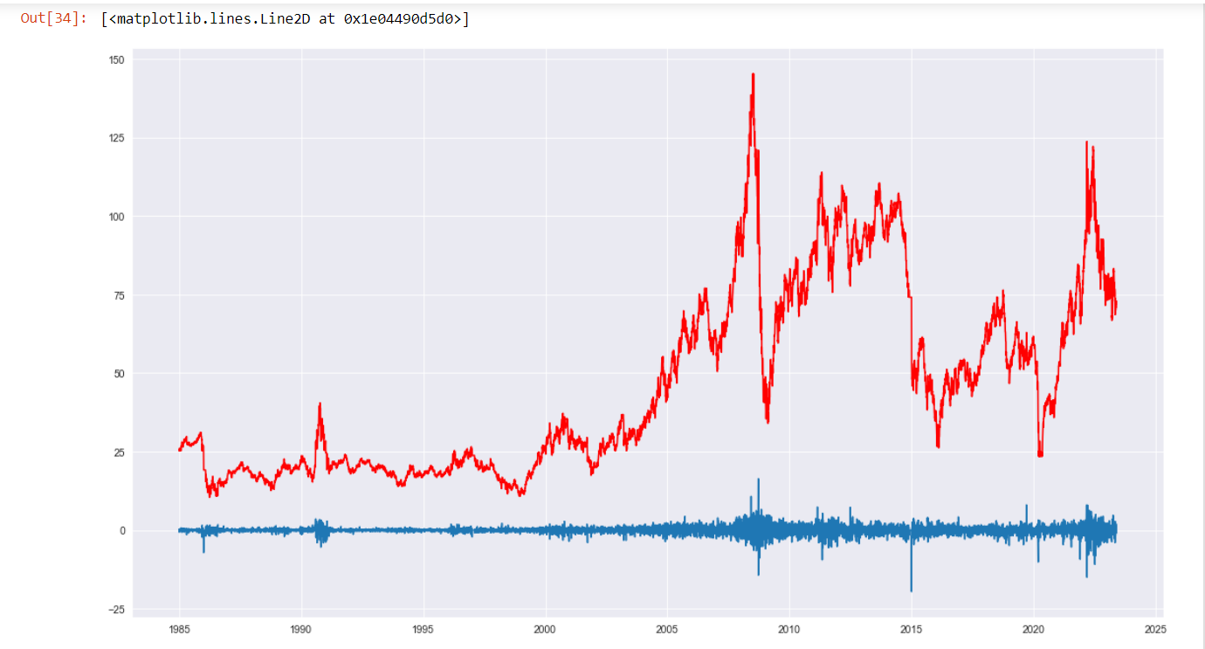
Transformation of data
We find our data is non stationary using Ad-Fuller test.
Convert non stationary data into stationary using differencing. So we get our data stationary in first differencing.

Slide 14

Model Building and Validation

Slide 15
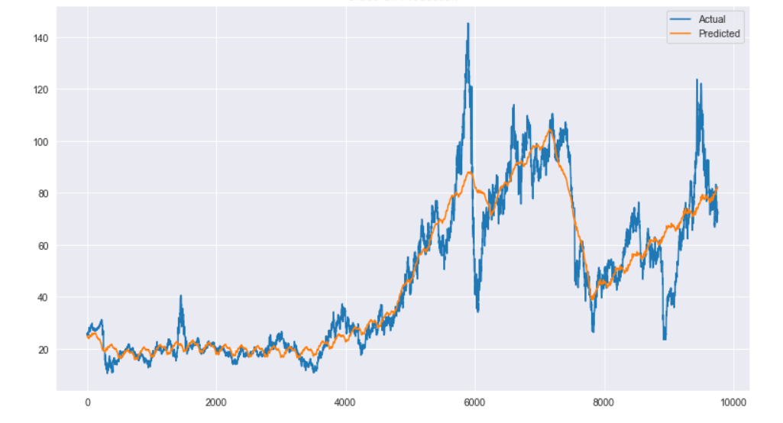
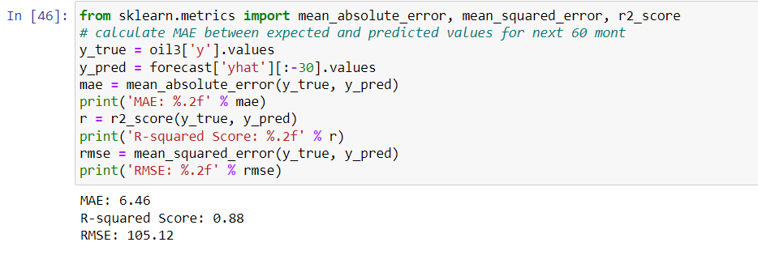
1.Prophet

Slide 16
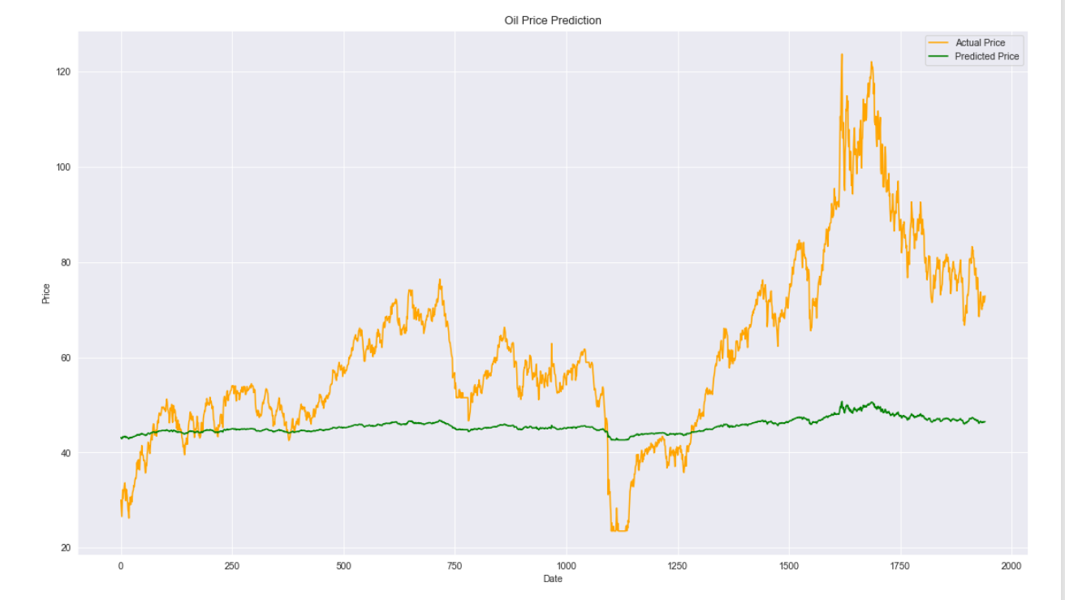
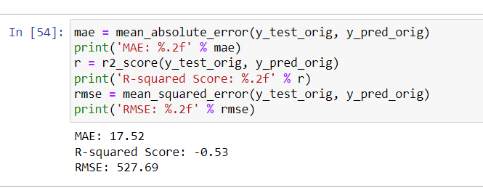
2.LSTM

Slide 17
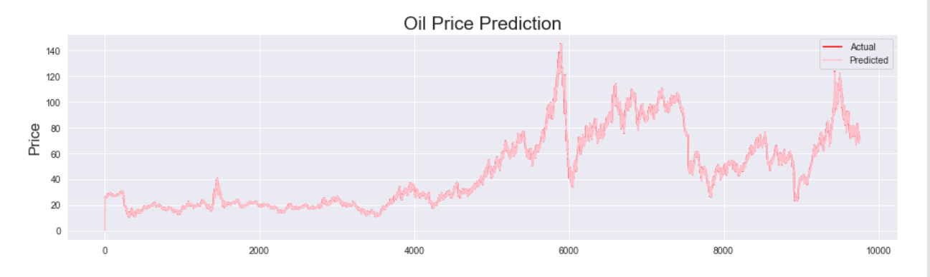
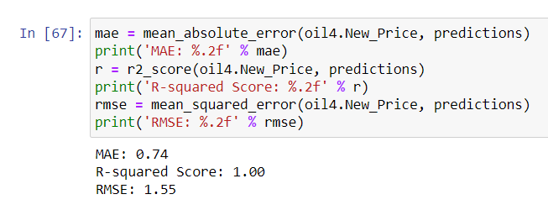
3.ARIMA

Slide 18
Model Evaluation
Sr.no. | Model | RMSE | MAE
1. | Prophet | 105.12 | 6.46
2. | LSTM | 527.69 | 17.52
3. | ARIMA | 1.55 | 0.74

Slide 19

Model Deployment

Slide 20
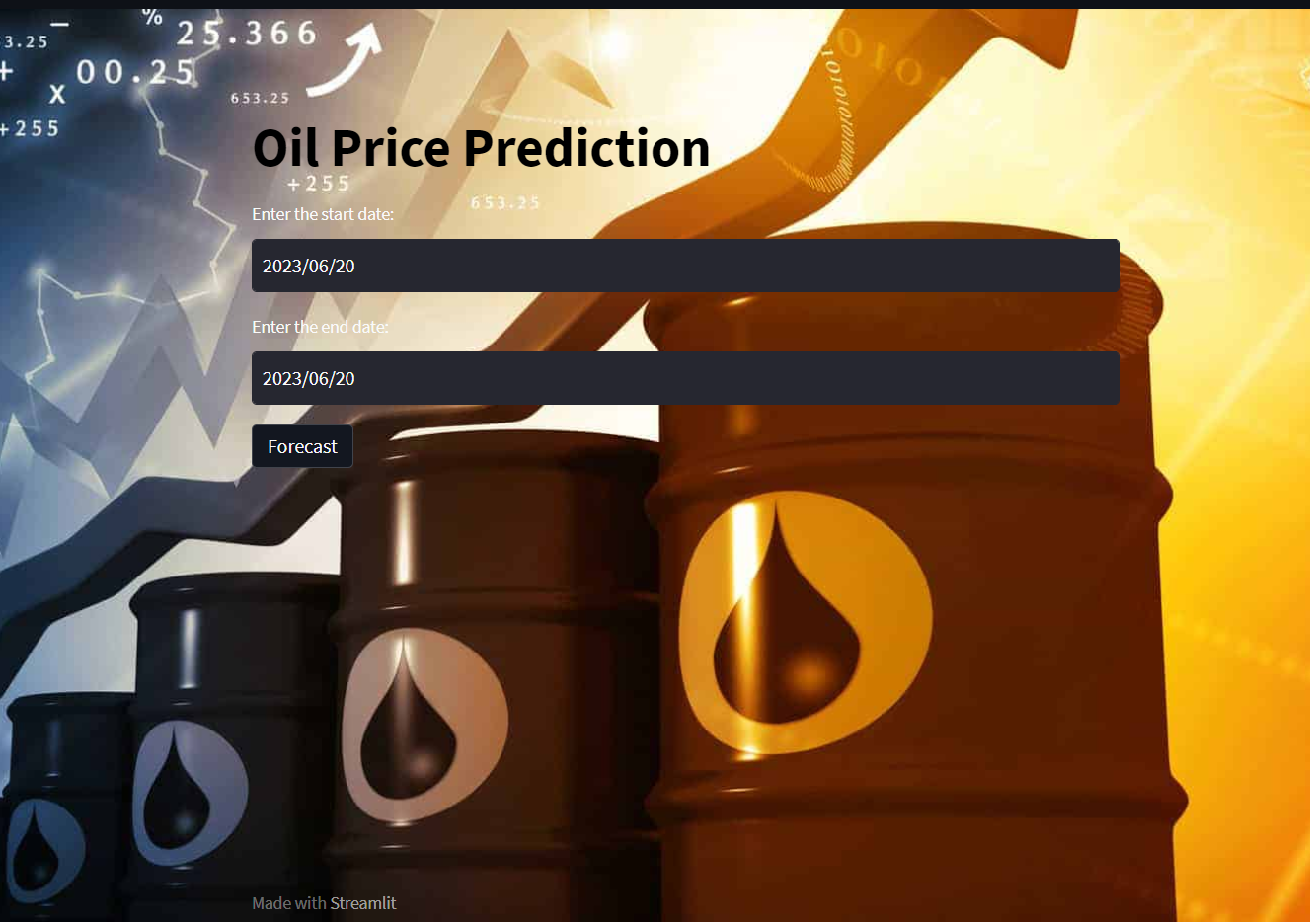
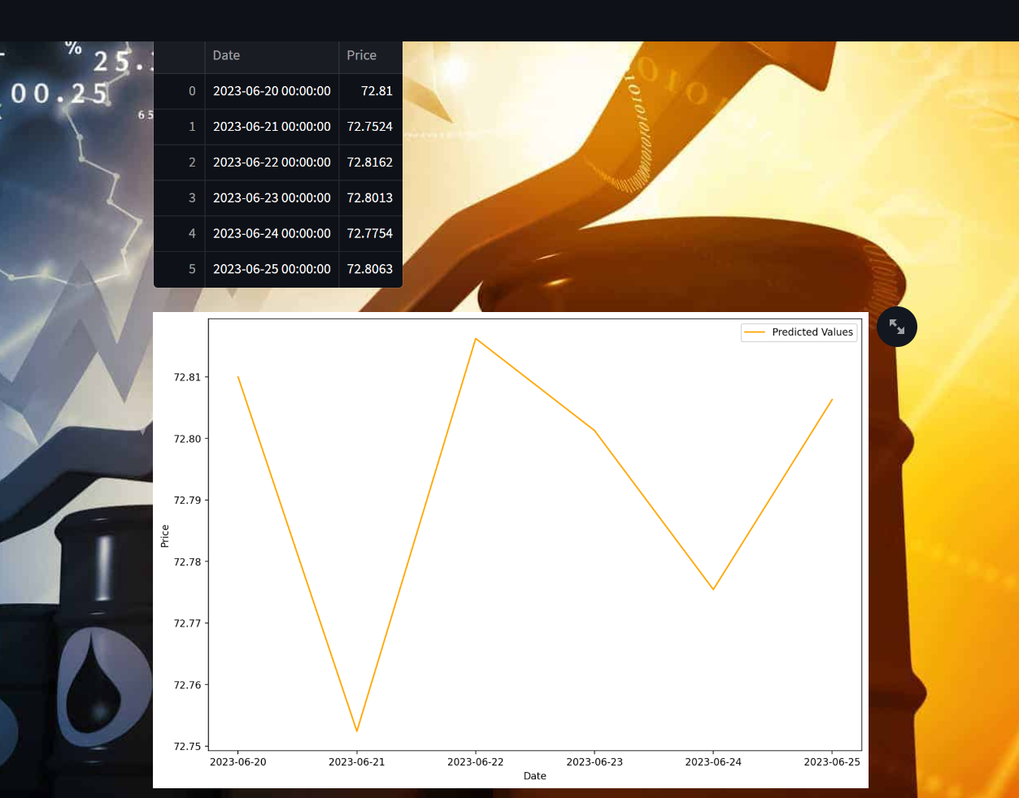
Deployment using Streamlit

Slide 21
THANK YOU

